Slide 1
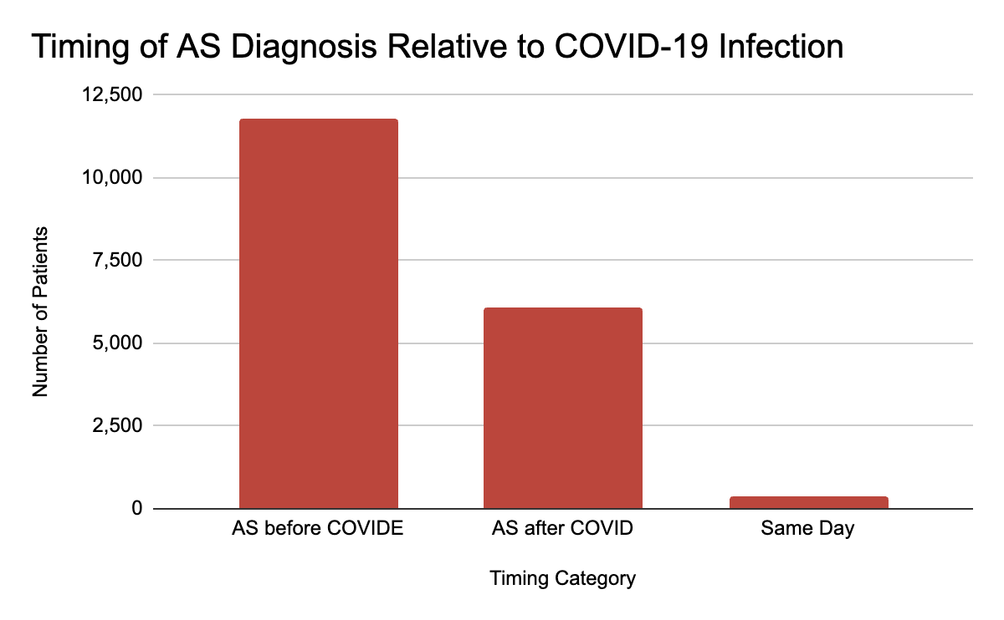
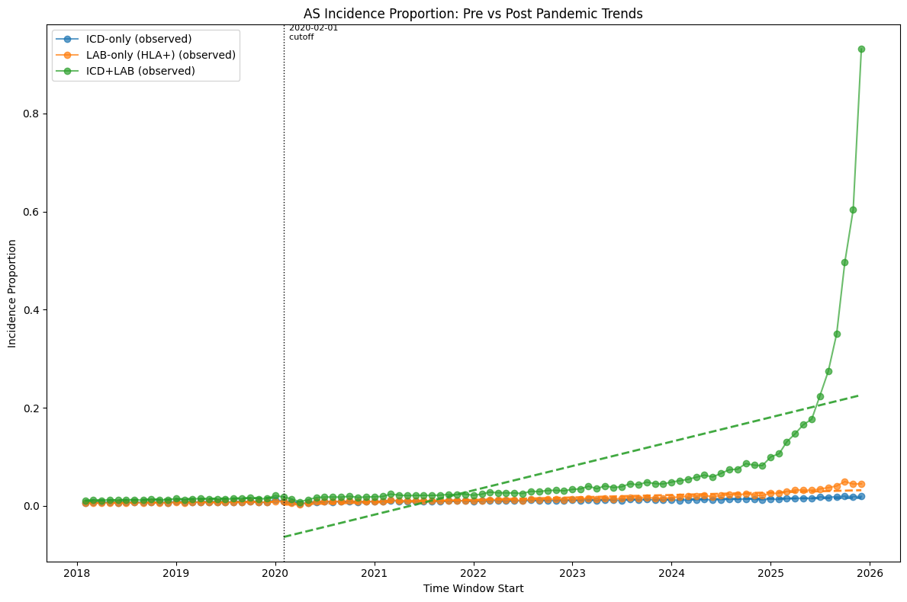
Evaluating Molecular Mimicry Signals in Ankylosing Spondylitis After COVID-19: A Large-Scale EHR Analysis
Matias Lee^{1,2}, Naomi Schlesinger³, Dorota Lebiedz-Odrobina³, Jessica Walsh^{3,4}, Julio Facelli^{1,2}, Ram Gouripeddi^{1,2}
¹Department of Biomedical Informatics, ²Utah Clinical and Translational Science Institute, ³Division of Rheumatology, University of Utah School of Medicine, Salt Lake City, UT, USA. ⁴Salt Lake City Veterans Affairs, Salt Lake City, UT, USA.
Background
Molecular mimicry between SARS-CoV-2 and host immune targets has been proposed as a mechanism linking COVID-19 to immune-mediated inflammatory diseases.
Ankylosing spondylitis has been identified as one of the strongest molecular mimicry signals¹.
It remains unclear whether these mechanistic findings translate into detectable population-level or longitudinal clinical patterns in real-world electronic health record (EHR) data.
Group | N
AS patients (dx or HLA-B27+) | 114246
COVID-positive patients | 51771
AS + COVID patients | 18273
Table 1. Cohort sizes derived from the TriNetX EHR dataset, including patients with Ankylosing Spondylitis (AS) defined by diagnosis codes or HLA-B27 positivity, COVID-19 positive patients, and the overlapping AS + COVID population used for downstream temporal analyses.
Results
Objective
Longitudinal analyses showed no strong evidence that COVID-19 was associated with immediate Ankylosing Spondylitis onset or short-term disease worsening based on diagnosis- and laboratory-based proxies.
Population-level incidence remained stable from 2018 through 2022.
When extended through 2025, a marked increase emerged, with a post- versus pre-COVID incidence ratio of approximately 7.8.
This increase was driven primarily by HLA-B27 laboratory testing rather than ICD-10 diagnosis codes, suggesting increased screening or delayed diagnosis rather than a direct effect on disease onset.
Evaluate whether COVID-19 is associated with changes in Ankylosing Spondylitis incidence, timing of diagnosis, and longitudinal clinical patterns using large-scale EHR data.
Figure 2. Distribution of AS diagnosis timing relative to COVID-19 infection. Most patients had AS diagnosed prior to COVID-19, while AS onset after COVID-19 was less frequent, suggesting no clear immediate temporal association.
Discussion
Methods
Across multiple analyses, no evidence was found supporting a direct short-term relationship between COVID-19 and Ankylosing Spondylitis onset or worsening.
Most patients had Ankylosing spondylitis diagnosed prior to COVID-19, and diagnostic frequency did not increase following infection.
Although some temporal proximity between COVID-19 and AS diagnosis was observed, this pattern was largely driven by early pandemic data (2020) and was not consistent across subsequent years.
This suggests that the apparent clustering is more likely explained by healthcare utilization, delayed diagnosis, and data recording patterns rather than a true biological effect.
The observed increase in AS incidence after 2025 appears to reflect increased HLA-B27 testing and potential delayed diagnosis, rather than a direct causal relationship.
While no clear acute longitudinal relationship was detected, the convergence of epidemiologic and mechanistic considerations warrants further longitudinal and mechanistic investigation to clarify causality and long-term clinical implications.
Data Source: Large-scale longitudinal analysis using EHR data from TriNetX, comprising approximately 300,000 Ankylosing spondylitis patients and ~788 million patient-level records through June 2025.
Data Processing: Diagnosis and laboratory data were transformed into an event-based longitudinal representation (patient–date–code structure) using scalable data engineering approaches (Parquet and Polars).
Cohort Definition: COVID-19 phenotypes were defined using National COVID Cohort Collaborative (N3C) criteria, integrating diagnosis codes and laboratory confirmation. Infection episodes were defined using a 30-day window to distinguish reinfections.
Analysis Strategy: Temporal relationships were assessed by comparing first COVID infection dates with first AS diagnosis dates. Population-level incidence trends were evaluated using TriNetX internally normalized metrics.
Acknowledgements
This research has been partially supported by the NIH National Center for Advancing Translational Sciences award UM1TR004409 [Utah CTSI]. Research computing for this project is provided by the Center for High Performance Computing, University of Utah. CHPC resources is partially funded by NIH Research Instrumentation Award S10OD021644. Data was obtained from the TriNetX Research Network. Content is solely the responsibility of the authors and does not necessarily represent the official views of the NIH. Contact: Matias Lee u1447587@utah.edu
Reference
Maldonado-Catala P, Gouripeddi R, Schlesinger N, Facelli JC. Molecular Mimicry Impact of the COVID-19 Pandemic: Sequence Homology Between SARS-CoV-2 and Autoimmune Diseases Epitopes. Immunoinformatics (Amst). 2025 Jun;18:100050. doi: 10.1016/j.immuno.2025.100050. Epub 2025 Mar 13. PMID: 40365241; PMCID: PMC12068837.
Figure 1. Distribution of AS diagnosis timing relative to COVID-19 infection. Most patients had AS diagnosed prior to COVID-19, while AS onset after COVID-19 was less frequent, suggesting no clear immediate temporal association.
Utah CTSI

